Slide 1
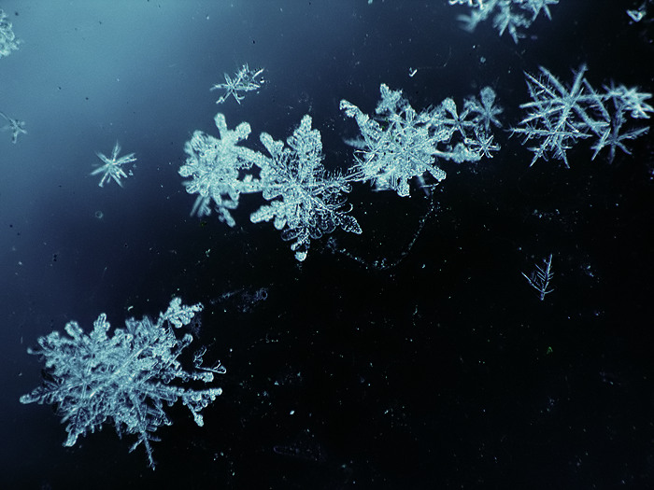

Духовно-нравственное воспитание школьника через урочную и внеурочную деятельность на английском языке
Zagorodneva Galina Vasilyevna,
English teacher of the highest qualification category;
Municipal Autonomous Educational Institution of the municipality of Nyagan "Secondary School No. 6" named after A. I. Gordienko, honorary citizen of Nyagan

Slide 2
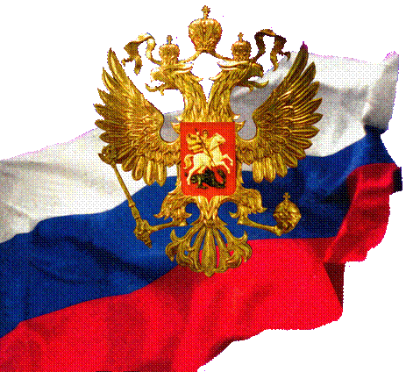
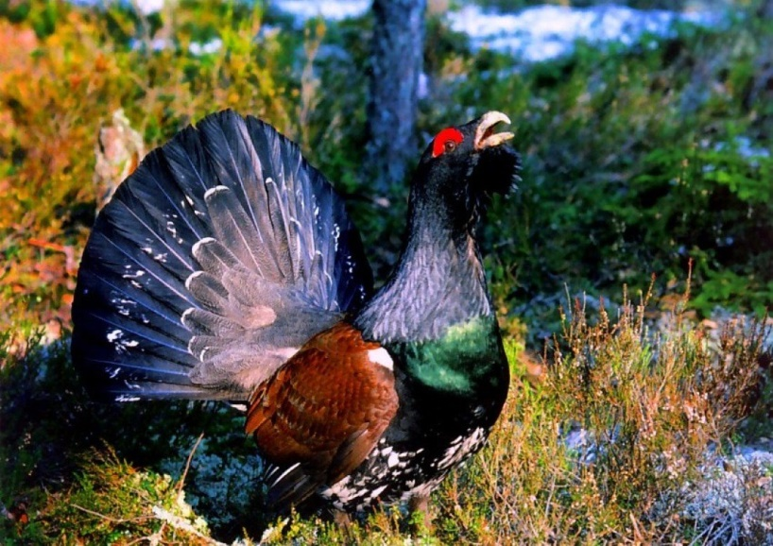
How are you going to build your Future, you are the Citizen of your country?

Slide 3
Tasks
To form and develop socially significant values of students that guide their personal, social and professional self-determination, namely:
- national dignity;
- tolerant attitude towards members of society;
- an active life position;
- love of the Motherland, a sense of community and belonging to the family;
- feelings of responsibility to yourself and others;
- social mobility

Slide 4

Khanty-Manseysky Okrug-Yugra
1. Pages from history.
2. The land of treasures.
3. My city.
4. We pay tribute to them.
5. They glorify our land.
6. Leisure and entertainment.
7. Our school magazines.
8. The majestic nature of my region

Slide 5
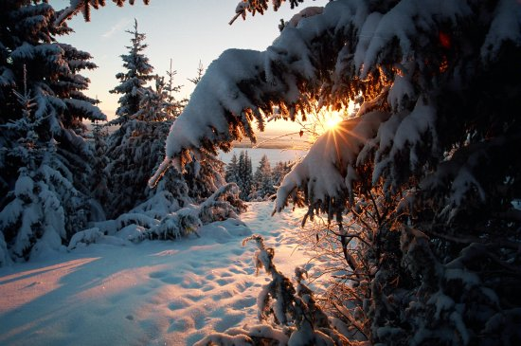
Joining Western Siberia to the Russian State
The civilised world learned of our region only in the end of 16 th century. Naturally, there was no such name as Khanty-Manseysk Okrug at the time. For a long time Europe showed little interest in the unexplored territories.
Before joining Western Siberia to the Russian State, the native population had lived in the primitive society.

Slide 6
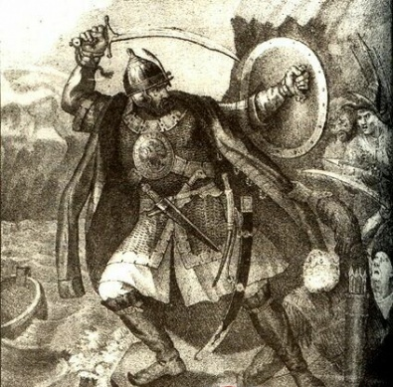
Сonquerors of Siberia
Cossak Ermak wan back Siberian lands from khan Kuchum. It was a very important victory. The population of khanty and mansy in the left bank of Ob were finally joined to the Russian State.

Slide 7
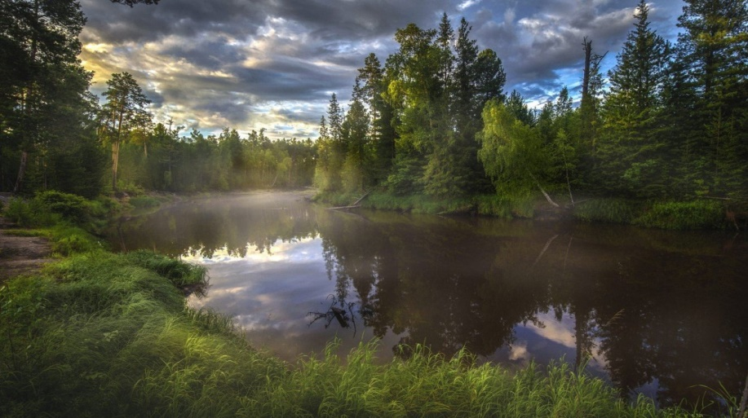
In 1594 F.P.Baryatinskey and V.Anichkov were sent to join the lands of Priobye. They came to khantyskey Prince Bardak , who voluntarily took out russian citizenship and helped to build the castle on the river Surgutka. The new city on the Ob was called Surgut and became the strong point for tsar’s power.

Slide 8
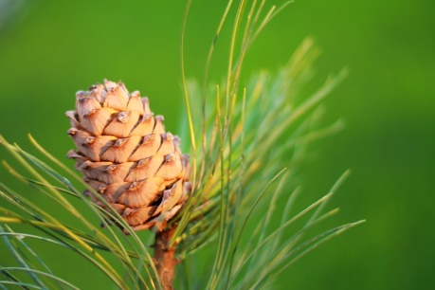
At the beginning of XYII century all the territory of Western Siberia became the part of Russia. Many new cities and centers were built.
Joining for the Russian State was important not only for political aim but played great role for industry, as these lands were the richest with natural resources.

Slide 9
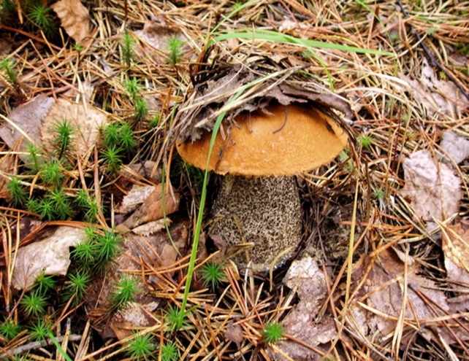
Khanty-Manseyskey Okrug is located in the middle part of continent and Russia, in the Western-Siberian plain. It occupies an area of 523,000 sq.km. The area of the region is twice as large as England and almost as large as Italy and Greece taken together. The southern point of it is located 59 north latitude and 60 east longitude. The borders of Okrug is 4750 km, it borders the Pripolyarney and North Urals to the west, Eastern Siberia to the east. KHMAO is the region of the Far North.

Slide 10
The main historical dates
The main historical dates of foundation of Khanty-Manseysk Autonomous Okrug:
1708-Decree of Peter the First to form Sibirskaya province (towns Berezov, Surgut)
1775-Decree of Ekaterina the Second to form Tobolsk province in which the whole Western Siberiya was included;
1918- Tobolsk province was renamed in Tyumen with principal center of a province is Tyumen;
1923- Uralskaya region was formed, Tobolskaya oblast and regions-Berezovskey, Surgutskey, Samarovskey,Kondinskey.
1930- Decree of VTSIK Ostyako-Vogulskey (Khanty-Manseyskey) national Okrug with the center in village Samarovo (town Khanty-Manseysk);
1934-with integration of Uralskoy oblast Ob-Irtyshskaya oblast was formed with the center in Tyumen; Okrug was included in Omskaya oblast;
1944-Tyumenskaya oblast was formed in which Khanty-Manseyskey National Okrug was included- the Decree of the Supreme Soviet of the USSR;
1977- Khanty-Manseyskey National Okrug got the status of autonomous;
1993- according to the Constitution of RF st.65 Khanty-Manseyskey Autonomous Okrug got the subject status of enjoying full rights;

Slide 11
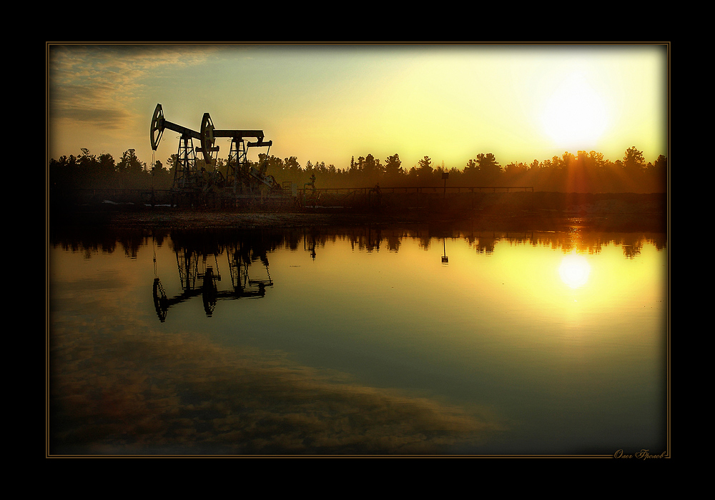
The main historical dates
Many russian people perceive “Khanty-Manseysk” and “oil” as the synonym-okrug is the main oil-bearing region of our country .
Availability of oil and gas on the territory of our okrug was predicted by Academician I.M.Gubkin in 1934. Drilling of bearing wells started in 1951. On the 21-st of September 1953 geological prospecting wells in Berezovo gave massive gusher, which changed greately the life of region and economy of the whole country.
On the 25-th of September in 1959 near Shaim (the region near town Uray) the oil-bearing strata was founded, In 1960 25, April -the first industrial oil was got from the well P-7. The first deposit of industrial siberian oil was opened.
In 1965 Samotlor ‘s deposit was opened, which is included in the first ten largest deposits in the world.
In 80-th the output of oil was a million tons in a day.

Slide 12
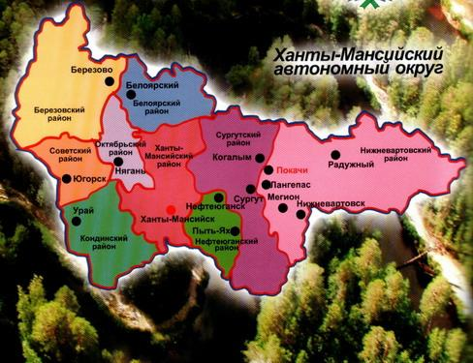

Slide 13
The Coat of Arms
The Coat of Arms of Khanty-Manseysk Autonomous Okrug is a silver emblem located on foundations of two shields inserted one in other and reproducing the bird stylized symbol "Кат ухуп вой" (two headed bird) (in the field of splited azure (blue) and green shield. The outline of the shield is traced out with gold. The motto “YUGRA” is outlined with silver letters on the azure ribbon under the shield.

Slide 14
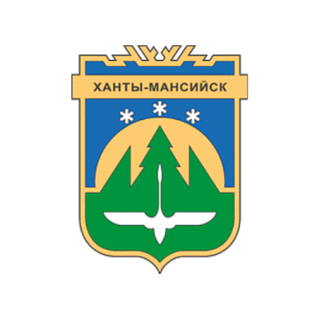
The territory of Autonomous Okrug includes 16 towns, 52villages and countries. They are Beloyarsky, Kogalym, Langepas, Megion, Nefteyugansk, Nizhnevartovsk, Nyagan, Pokachi, Pyt-Yakh, Raduzhny, Surgut, Urai, Yugorsk, Beryozovo, Kondinsky, Sovetsky and others. Administrative center of our okrug is Khanty-Manseysk.

Slide 15
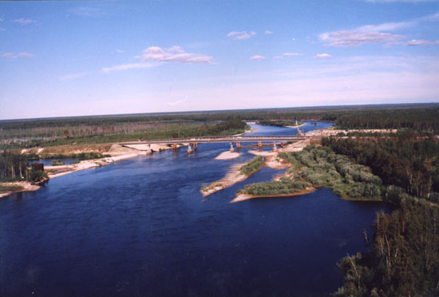
Okrug is situated in one natural zone-woodland. The main part of it is heavy marshy taiga. Among marsh and forests there are 25 thousand lakes. The largest rivers of Russia are the Ob and the Irtysh, which flow through our territory from the south to the north. The important tributaries of the Ob are the Vakh, the Agan, theTromegan, the Bolshoy Ugan, the Lyamin, the Pim,the Bolshoy Salym, the Nazym, The North Sosva, the Kazym; the tributaries of the Irtysh are the Konda and the Sogom

Slide 16
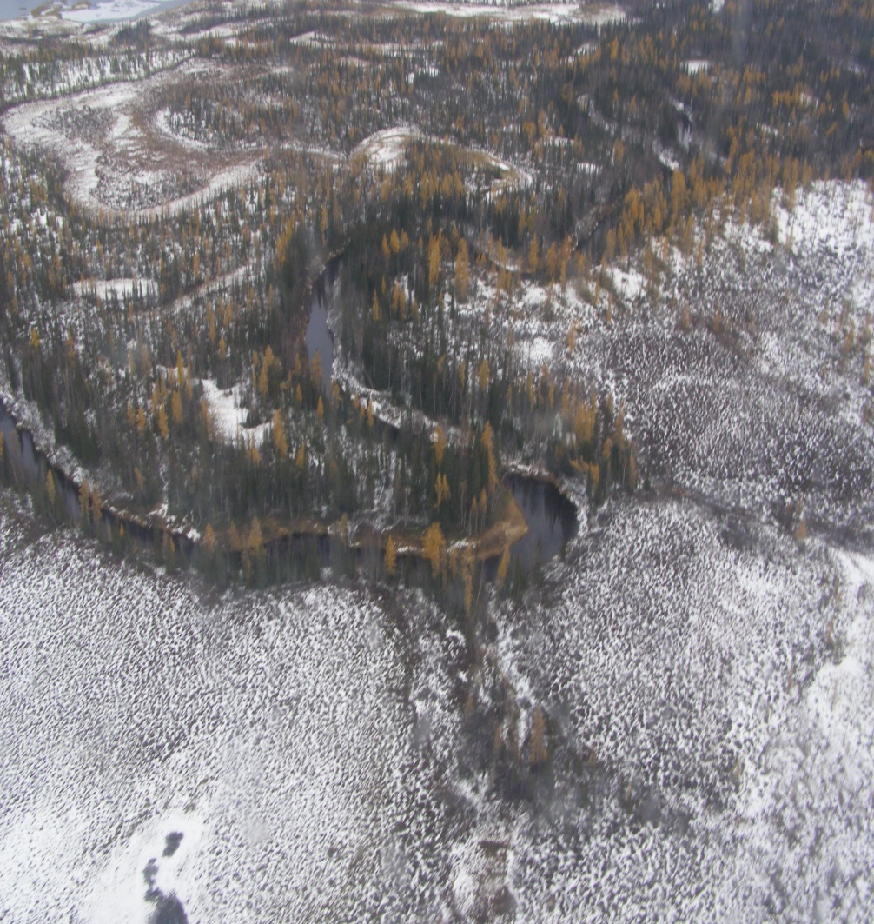
Our Okrug is very large in size. Imagine yourself in a plane flying over its territory. You will see wonderful sights: blue lines of the rivers, blue mirrors of the lakes, green forests and hills. You will enjoy every minute of your flight.
Our land is remarkable for its wealth. There is coal, peat, oil, gas and wood.

Slide 17
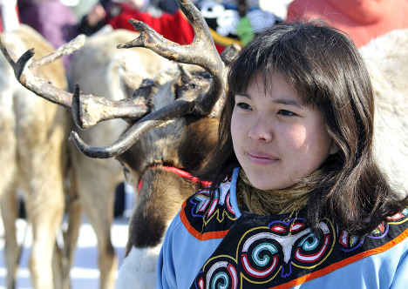
The nature and peoples inhabiting our Okrug are given the most important thing-faith. It is great faith that brings us together. It’s faith that makes us patient and understanding, the qualities which help us live and survive in the most hard times.

Slide 18
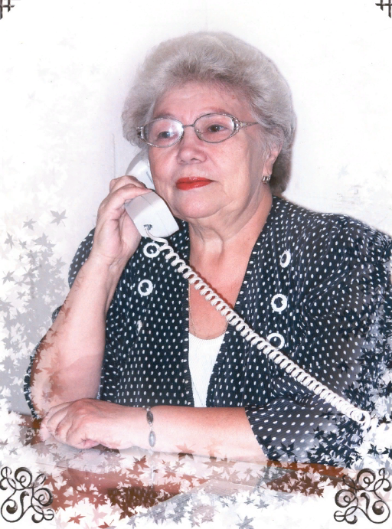
The national property which makes us proud is its greatness: scientists, experts, famous philosophers, outstanding inventors, musicians, writers, artists.
Гордиенко Августа Ивановна

Slide 19
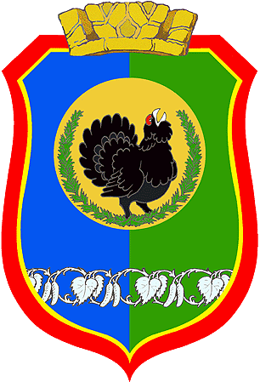
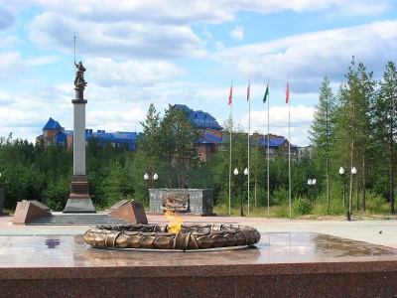
OUR TOWN
The Coat of Arms is a green and azure shield symbolizing the beauty and plenty of natural riches and clear sky. In the centre of it there is a wood-grouse symbolizing wisdom, flourishing and prosperity. The red background with the elements of deer’s antlers says that Nyagan belongs to Khanty- Manseysk Okrug.
Nyagan

Slide 20
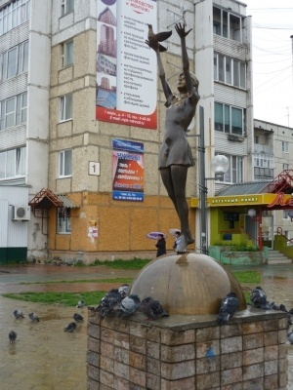
The world learned of our town only in the 20-th century. In 1985 it was given the status of town, it is included in the Khanty-Manseysk Autonomus Okrug - Yugra. Our town is located in western Siberia, and occupies an area of 816 km, or 94 ha. Nyagan is 300 km away from Khanty- Manseysk.

Slide 21
The origin of the town’s name comes from the river Nyakh- Ugan. “Nyakh” in the translation of Khantys language is “smile”.
The population of Nyagan is about 59 thousand people. It is inhabited by various ethnic groups: Russians, Ukrainians, Tatars, Khantys, Moldavians, Bashkirs, Uzbeks and others. But the first settlements in this place were Khaymasovs.

Slide 22
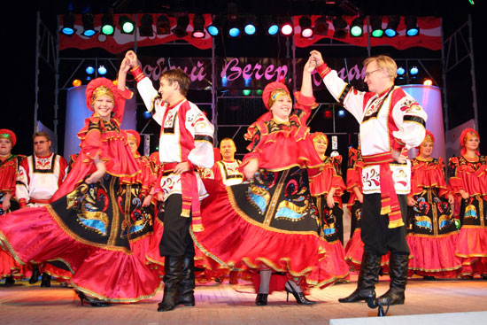
People bring fame to our town

Slide 23
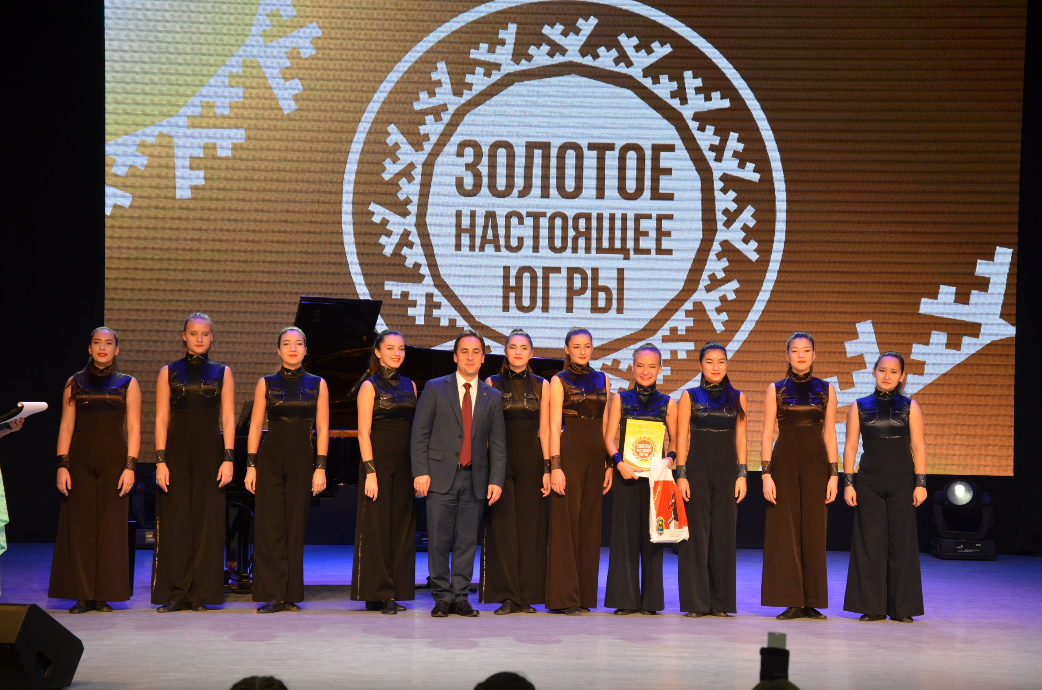
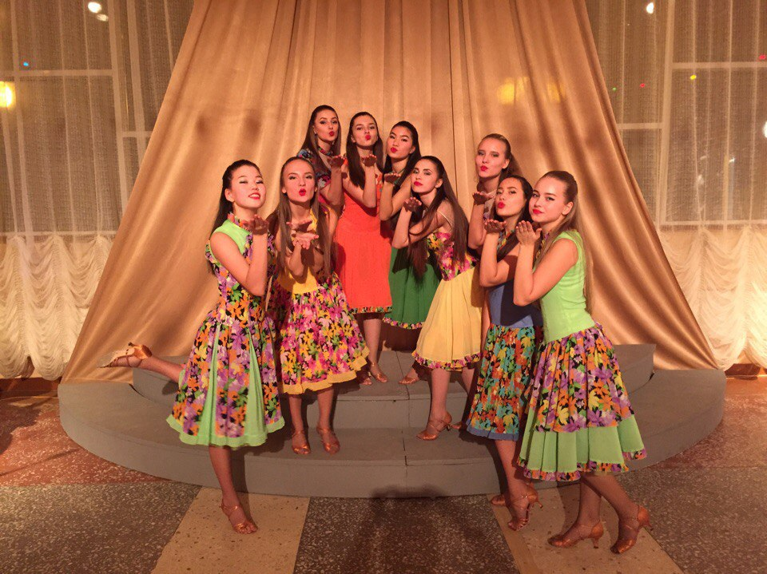
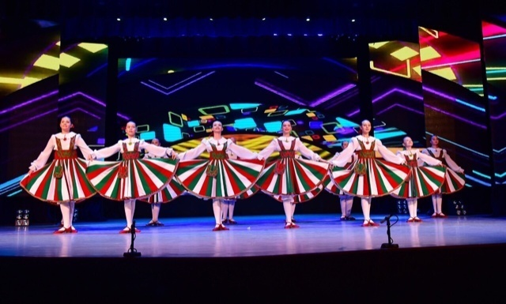
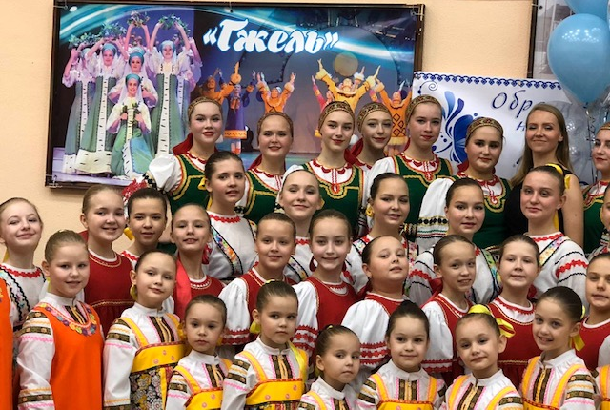
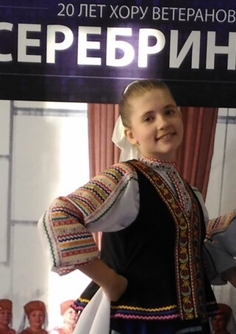
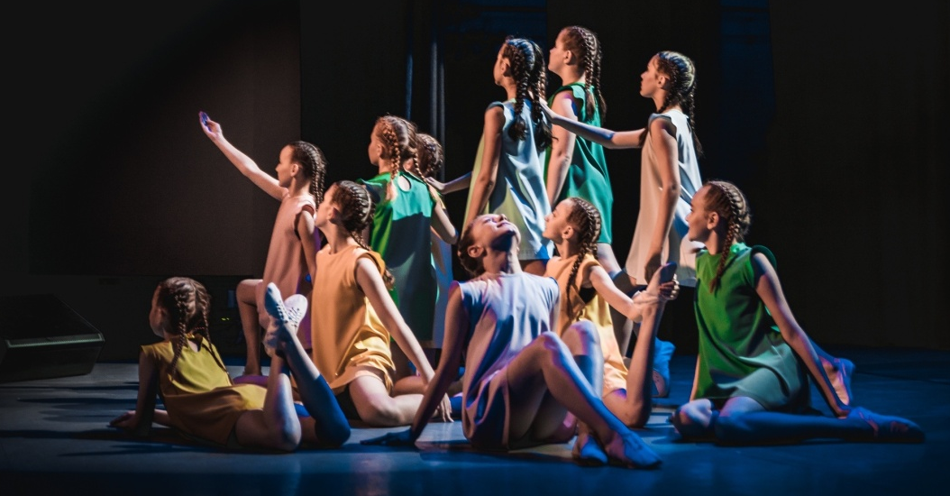

Slide 24
We can enjoy the most beautiful view of the town from plane. Nyagan is a pleasure to walk around too. The heart of the city is the Square in the third district. The Square is the place where different meetings, festivals and demonstrations take place. It is the favourite place of rest for the citizens of Nyagan. On the left of the Square is the park with the Monument of Georgey Pobedonosets and the Monument to the Heroes of World II. The eternal flame leaves nobody indifferent. Citizens, guests and tourists come here to pay tribute to those who died at the front during the war. On the right of the Square we can see the Museum. The Museum is a place to enjoy paintings by local artists. Each year many exhibitions from other parts of Russia are arranged there. There is the Temple of Saint Alexey and the Mosque in our town. You can see small monuments “The girl with a Dove”, “Oilmen” and “Caretaker and Plumber”. You can visit the Cultural Centre of Small Siberian People. The local Musical Drama Theatre welcomes a great number of spectators every year. They enjoy the performances of the local companies as well as those of touring companies from Moscow, Ekaterinburg, Novosibirsk.

Slide 25
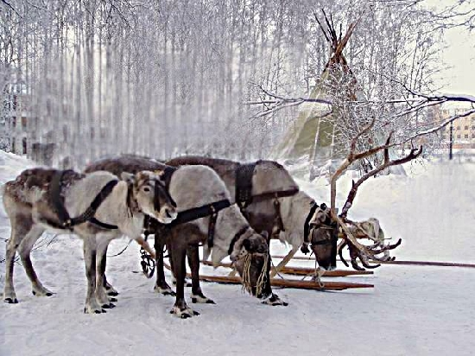
Nyagan is a taiga town. Forests cover its territory. The climate is cold. Winters are cold and long; they usually begin in October and last until April. Cold temperatures of -40 0C are common in our region, but the heat of +30 0 C occurs in July.

Slide 26
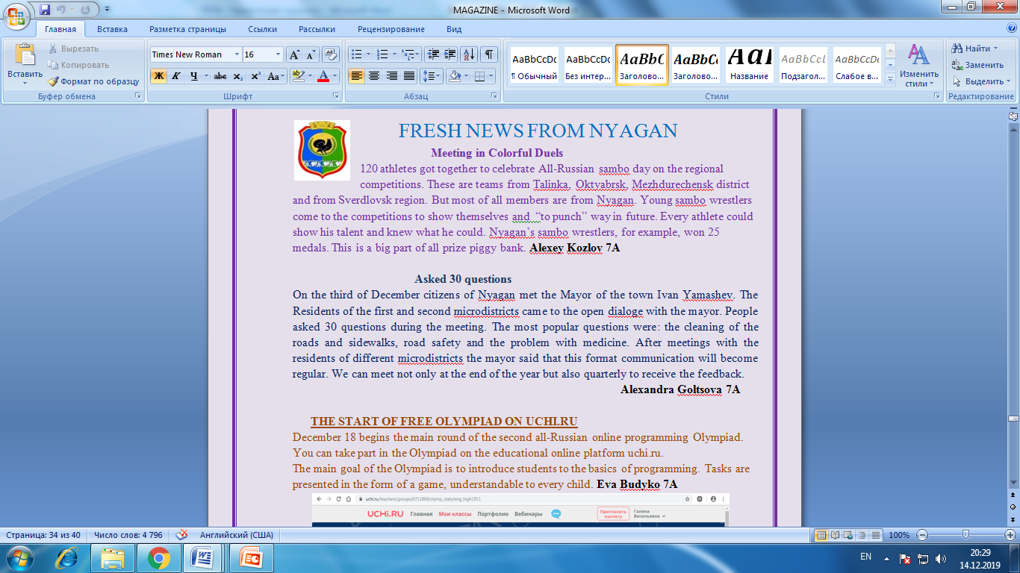

Slide 27
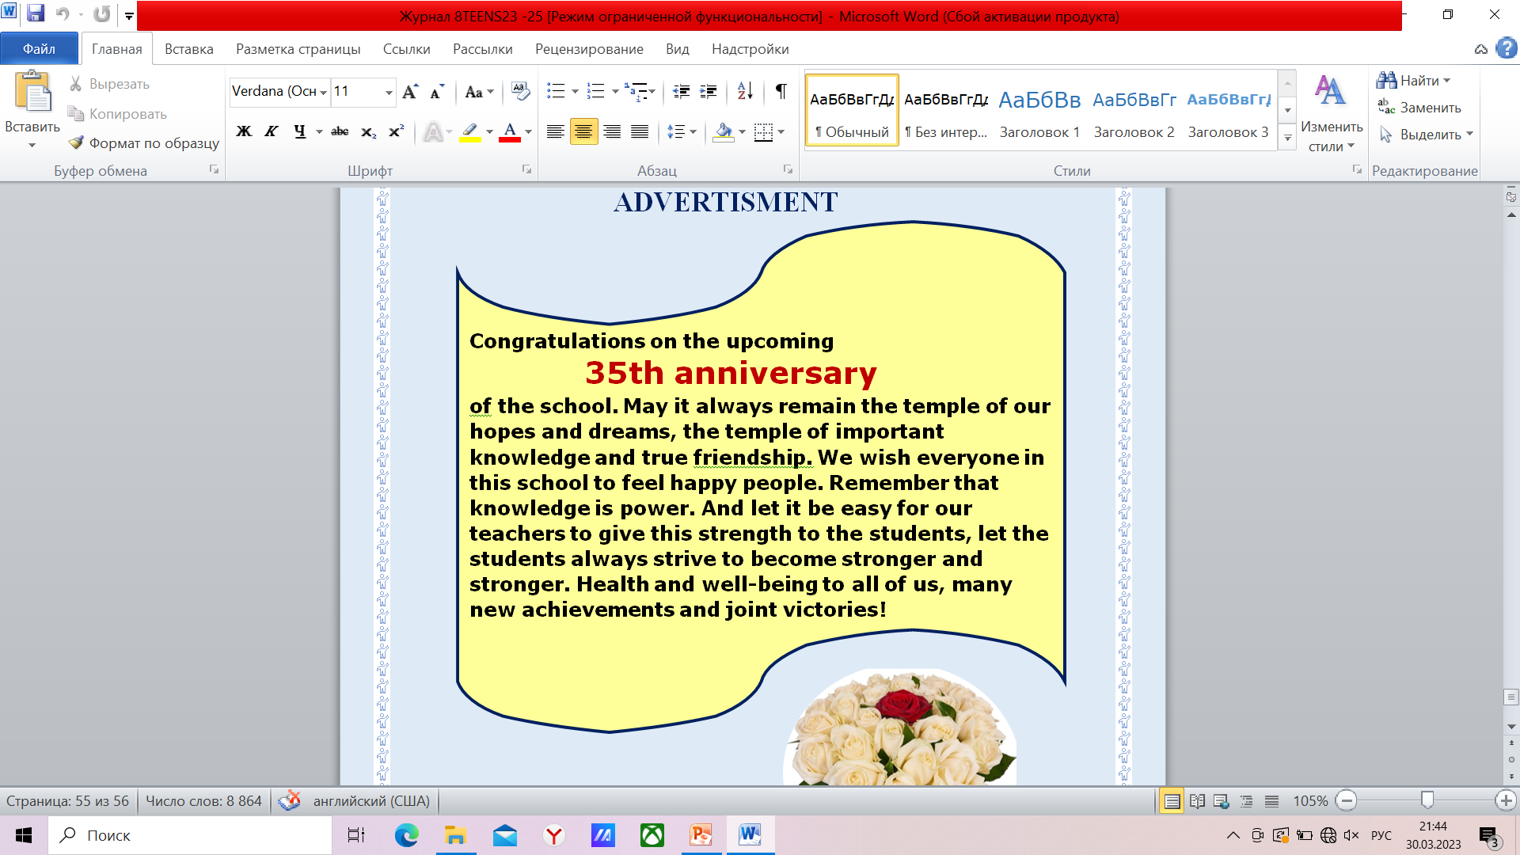
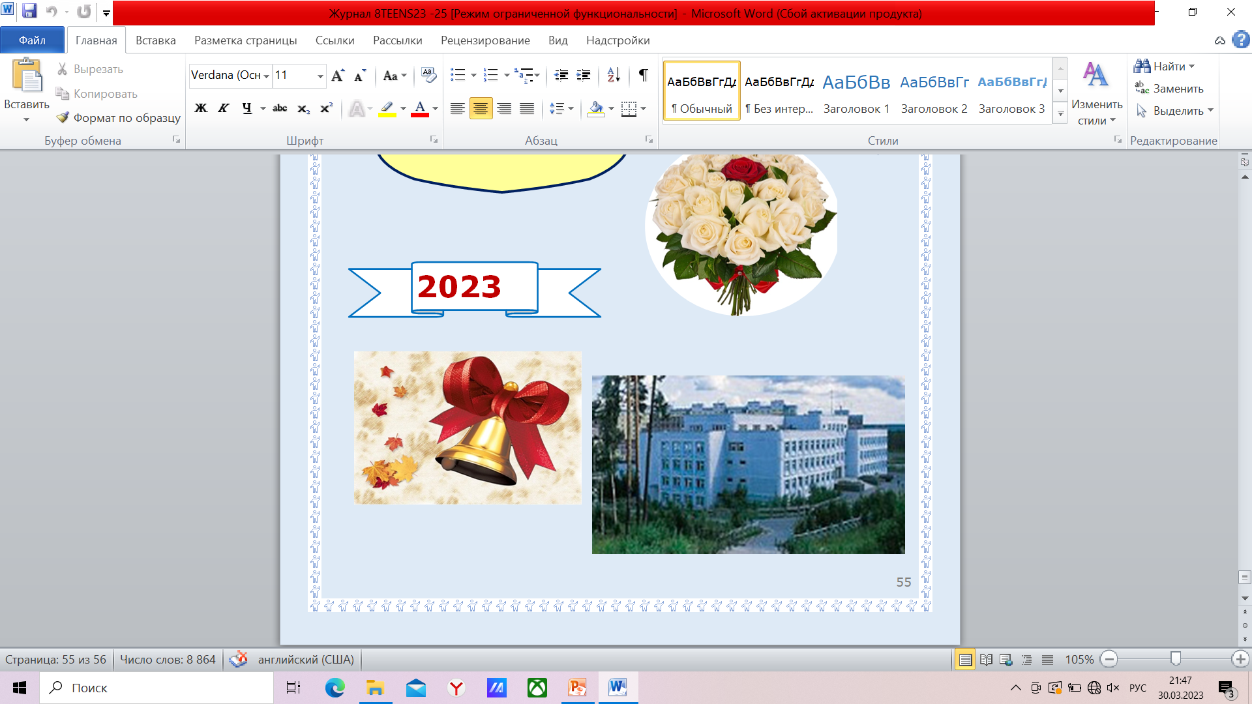

Slide 28
Life is a Miracle
From children through to adulthood
We change at every turn
As life brings opportunities
And lessons we can learn
Life truly is a miracle
We’re changing day to day
Our looks, our personalities
The things we do and say
We change the way we speak and act
The way we think and feel
As we move through life’s cycle
On that ever-spinning wheel!
We have a fresh start every day
The world is bright and new
So many possibilities
There’s nothing we can’t do
No pessimist ever
discovered the secret of the stars or sailed to an uncharted land, or opened a new doorway for the human spirit.
Helen Keller (US deafblind author)

Slide 29
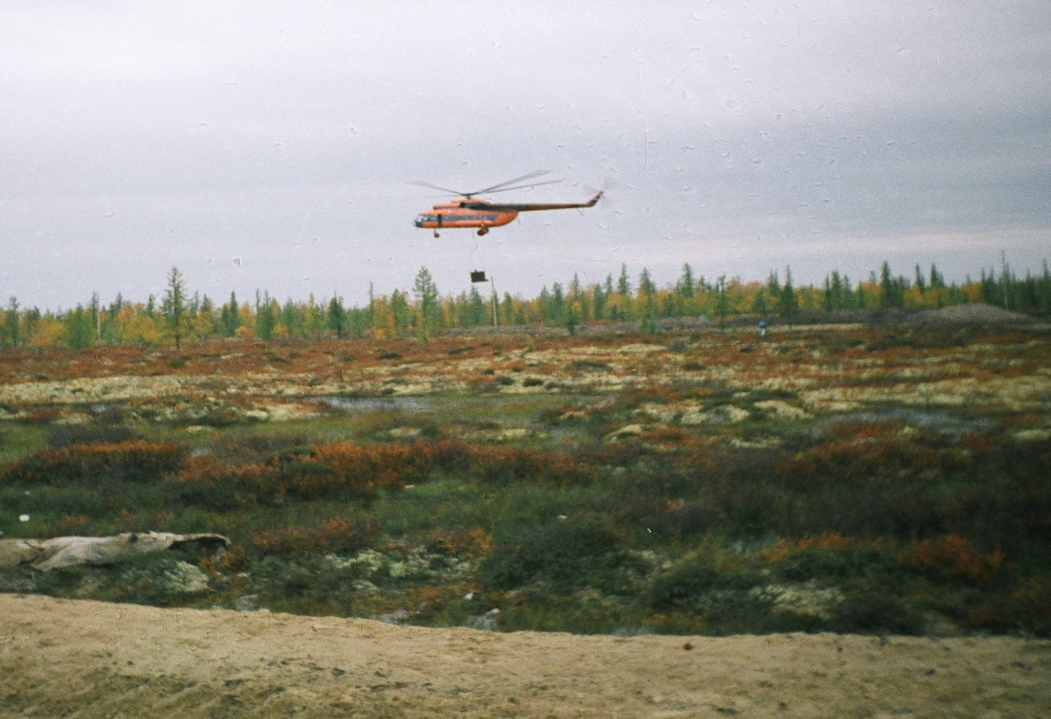
In the KHMAO-YUGRA the main transportation is by rivers and by train, 29 %-automobile and 2%- by air.
WELCOME!

Slide 30
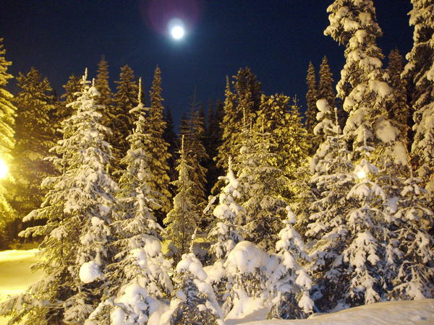
Our Nature
TAKE CARE OF NATURE

Slide 31
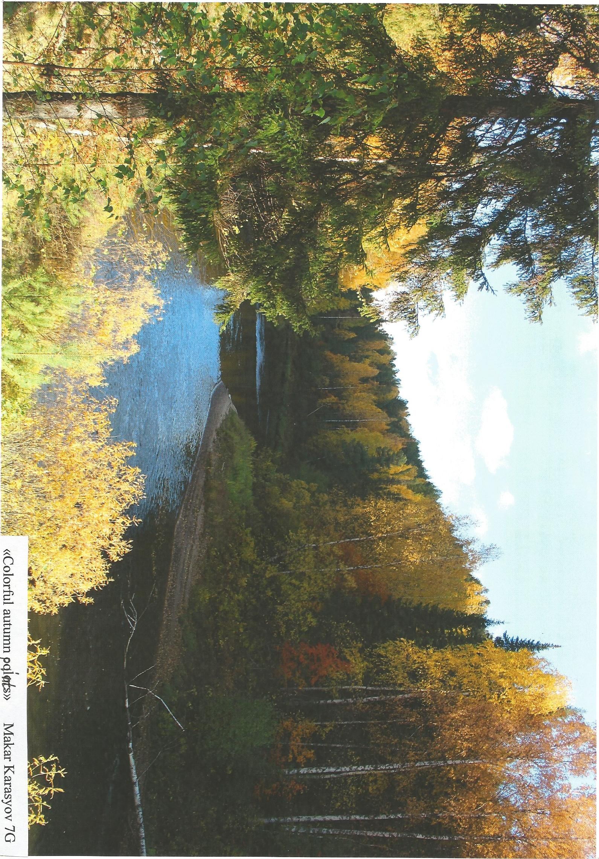

Slide 32
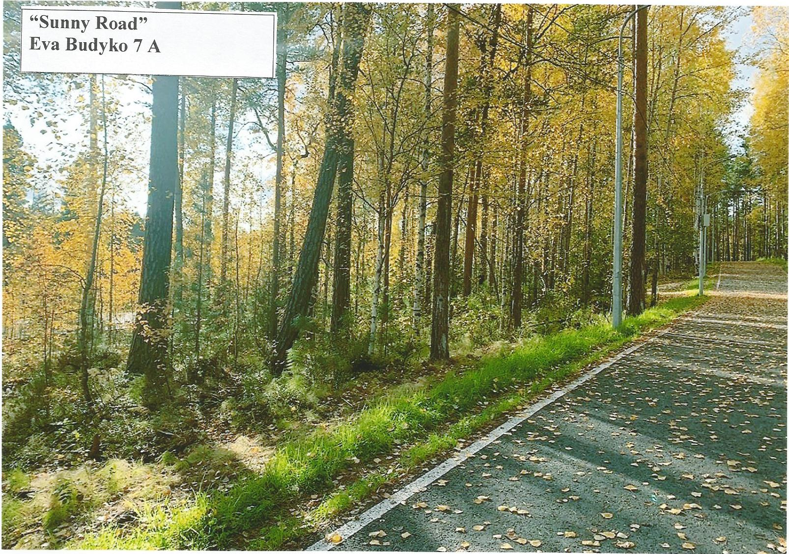

Slide 33
Использованные материалы:

