Slide 1
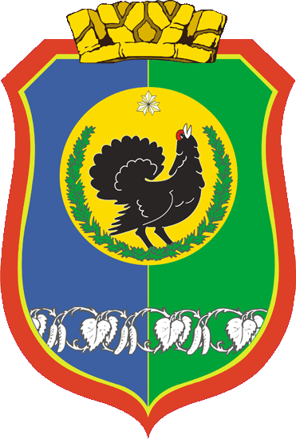
THERE IS NO PLACE LIKE NYAGAN

Slide 2
The world learned of our town only in the 20-th century. In 1985 it was given the status of town, it is included in the Khanty-Manseysk Autonomus Okrug - Yugra. Our town is located in western Siberia, and occupies an area of 816 km, or 94 ha. Nyagan is 300 km away from Khanty- Manseysk.

Slide 3
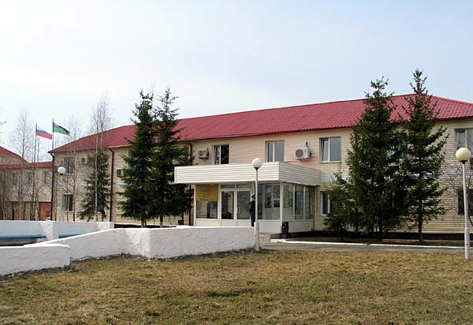
The building of Town Administration

Slide 4
The origin of the town’s name comes from the river Nyakh- Ugan. “Nyakh” in the translation of Khantys language is “smile”.
The population of Nyagan is about 57 thousand people. It is inhabited by various ethnic groups: Russians, Ukrainians, Tatars, Khantys, Moldavians, Bashkirs, Uzbeks and others. But the first settlements in this place were Khaymasovs.

Slide 5
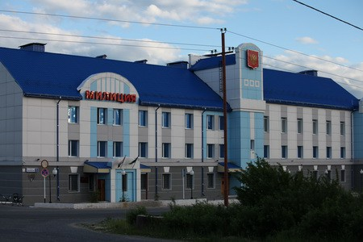
The building of Militia

Slide 6
Nyagan is a taiga town. Forests cover its territory. The climate is cold. Winters are cold and long; they usually begin in October and last until April. Cold temperatures of -40 0C are common in our region, but the heat of +30 0 C occurs in July.

Slide 7
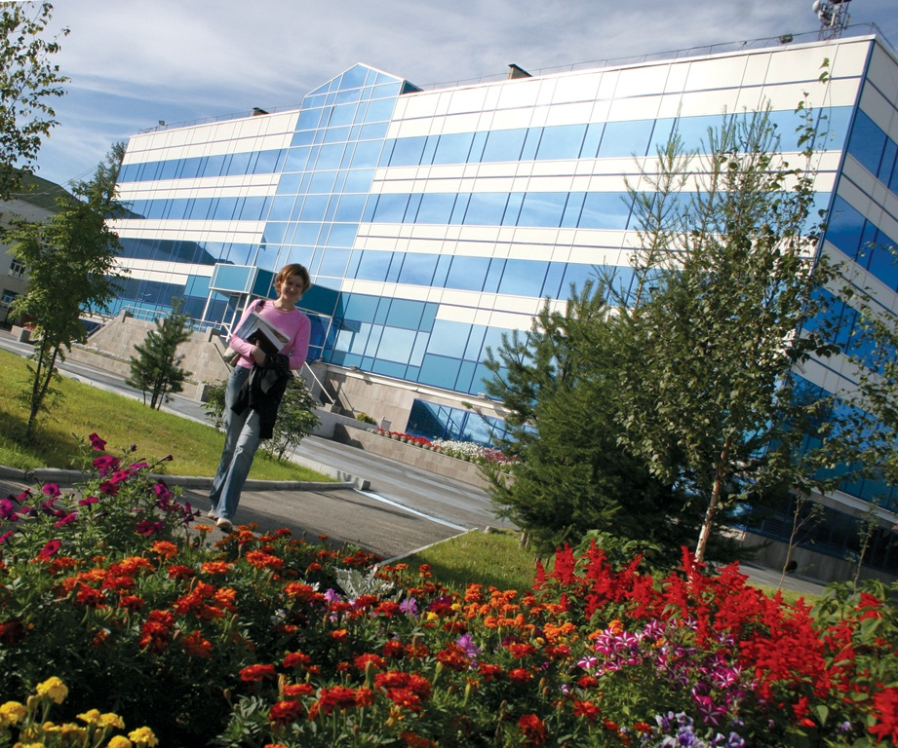
Tyumen-Petroleum Company

Slide 8
We can enjoy the most beautiful view of the town from plane. Nyagan is a pleasure to walk around too. The heart of the city is the Square in the third district. The Square is the place where different meetings, festivals and demonstrations take place. It is the favourite place of rest for the citizens of Nyagan. On the left of the Square is the park with the Monument of Georgey Pobedonosets and the Monument to the Heroes of World II. The eternal flame leaves nobody indifferent. Citizens, guests and tourists come here to pay tribute to those who died at the front during the war. On the right of the Square we can see the Museum. The Museum is a place to enjoy paintings by local artists. Each year many exhibitions from other parts of Russia are arranged there. There is the Temple of Saint Alexey and the Mosque in our town. You can see small monuments “The girl with a Dove”, “Oilmen” and “Caretaker and Plumber”. You can visit the Cultural Centre of Small Siberian People. The local Musical Drama Theatre welcomes a great number of spectators every year. They enjoy the performances of the local companies as well as those of touring companies from Moscow, Ekaterinburg, Novosibirsk.

Slide 9
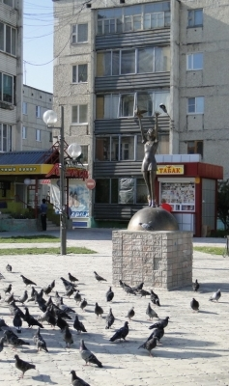
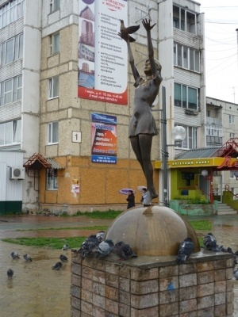
The Girl with a Dove

Slide 10
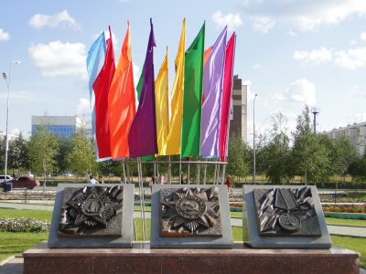
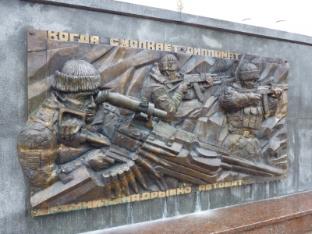
The monument to the Heroes of World II

Slide 11
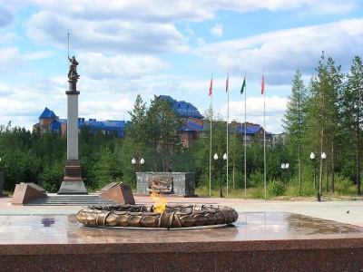
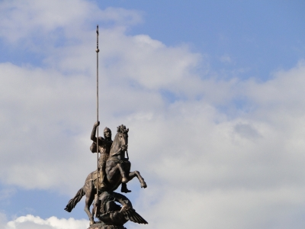
The park with the monument of Georgey Pobedonosets

Slide 12
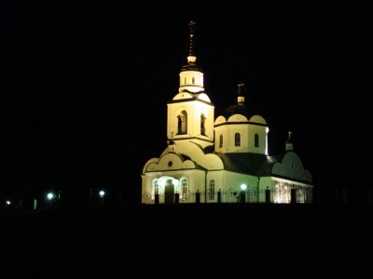
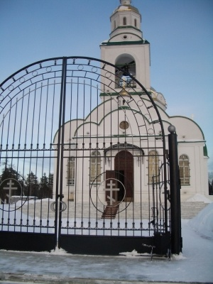
The Temple of Saint Alexey

Slide 13
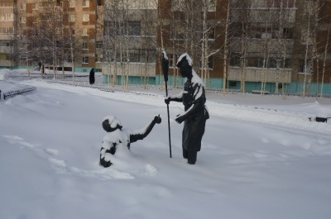
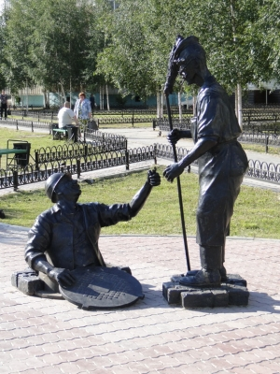
Caretaker and Plumber

Slide 14
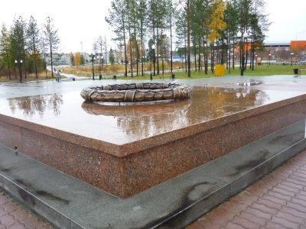
The eternal flame

Slide 15
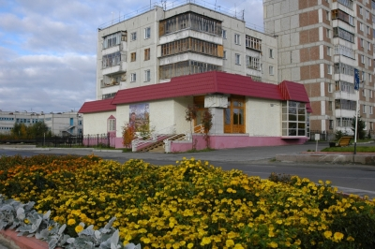
The Museum

Slide 16
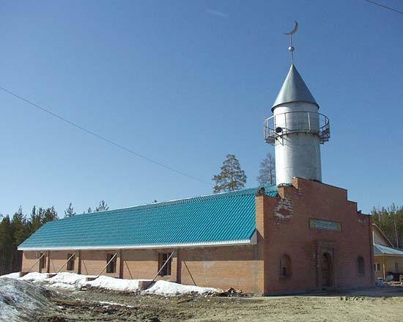
The Moscue

Slide 17
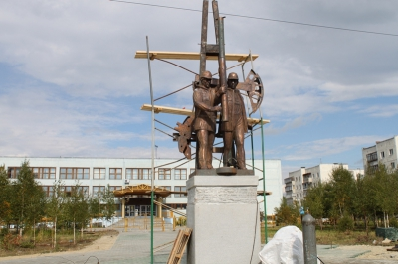
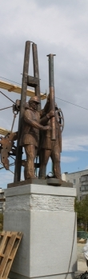
Oilmen

Slide 18
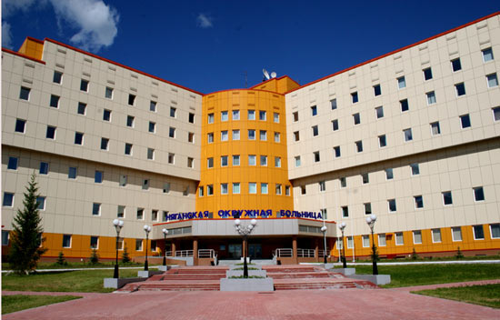
Medical establishment

Slide 19
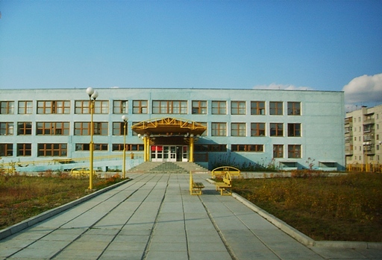
University

Slide 20
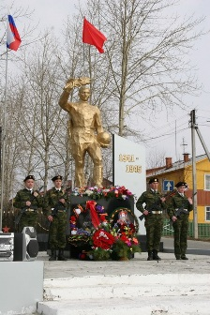
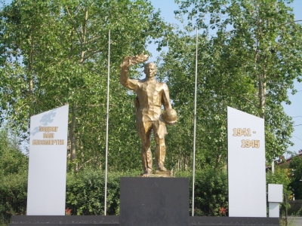
The Monument to the Heroes of World II

Slide 21
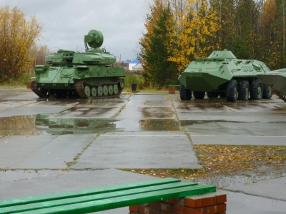
Tanks

Slide 22
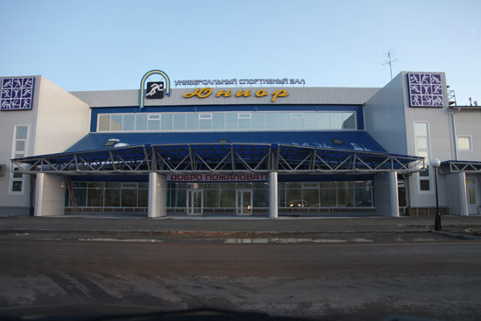
Sport Hall “Yunior”

Slide 23
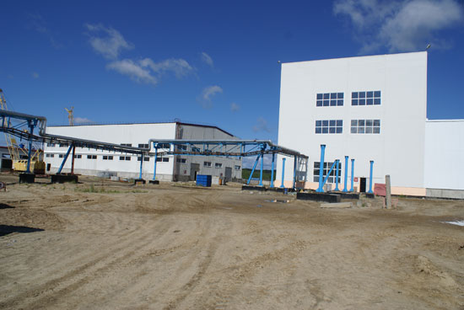
“Polar Quartz”

Slide 24
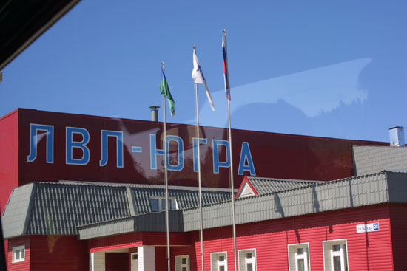

Slide 25
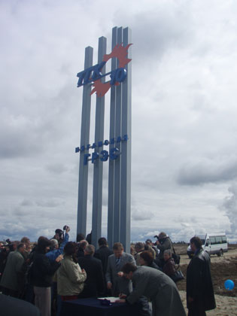

Slide 26
The pride of any country is its people. The name of Mariya Sharapova is known not only in the Okrug, but in the world. Thus we can say that it is people and their deeds that bring fame to their region and Motherland.
People should know as much as possible about our town because it is the history of the whole country.

Slide 27
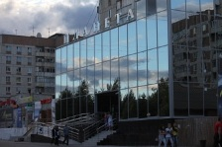
The Cultural Centre “Planeta”

Slide 28
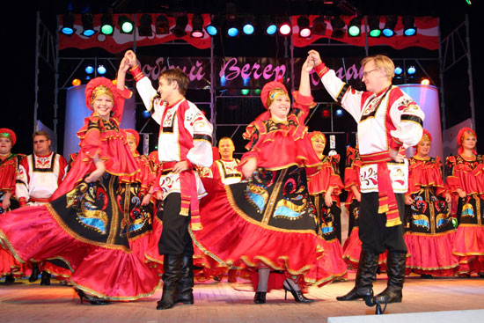
People bring fame to our town

Slide 29
THE COAT OF ARMS

Slide 30
The Coat of Arms is a green and azure shield symbolizing the beauty and plenty of natural riches and clear sky. In the centre of it there is a wood-grouse symbolizing wisdom, flourishing and prosperity. The red background with the elements of deer’s antlers says that Nyagan belongs to Khanty- Manseysk Okrug.

Slide 31
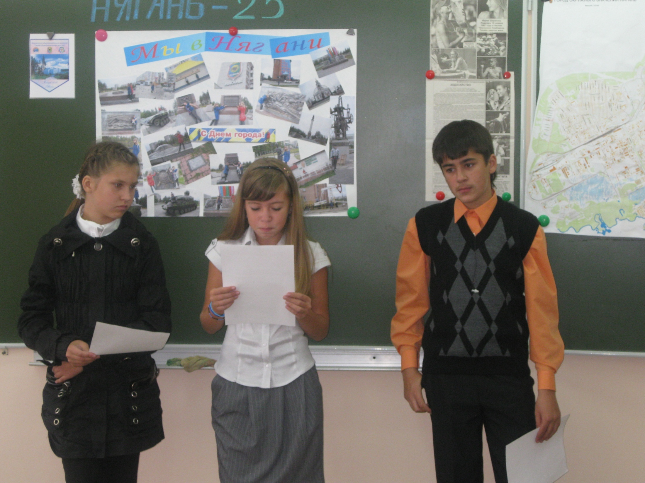

Slide 32
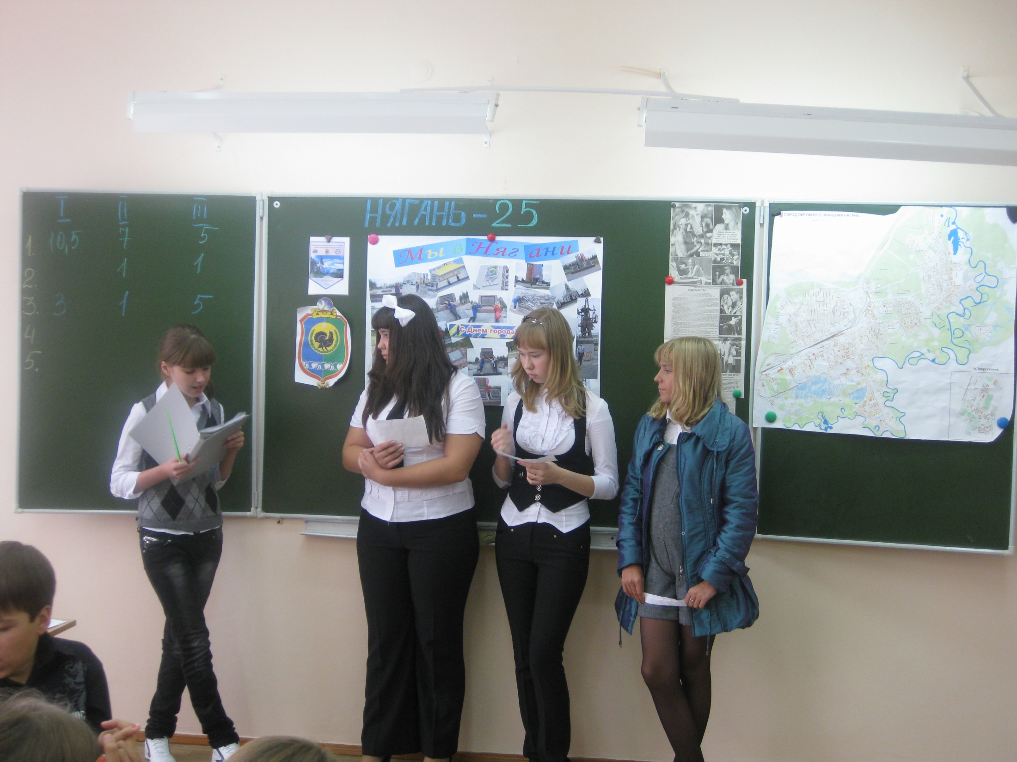

Slide 33
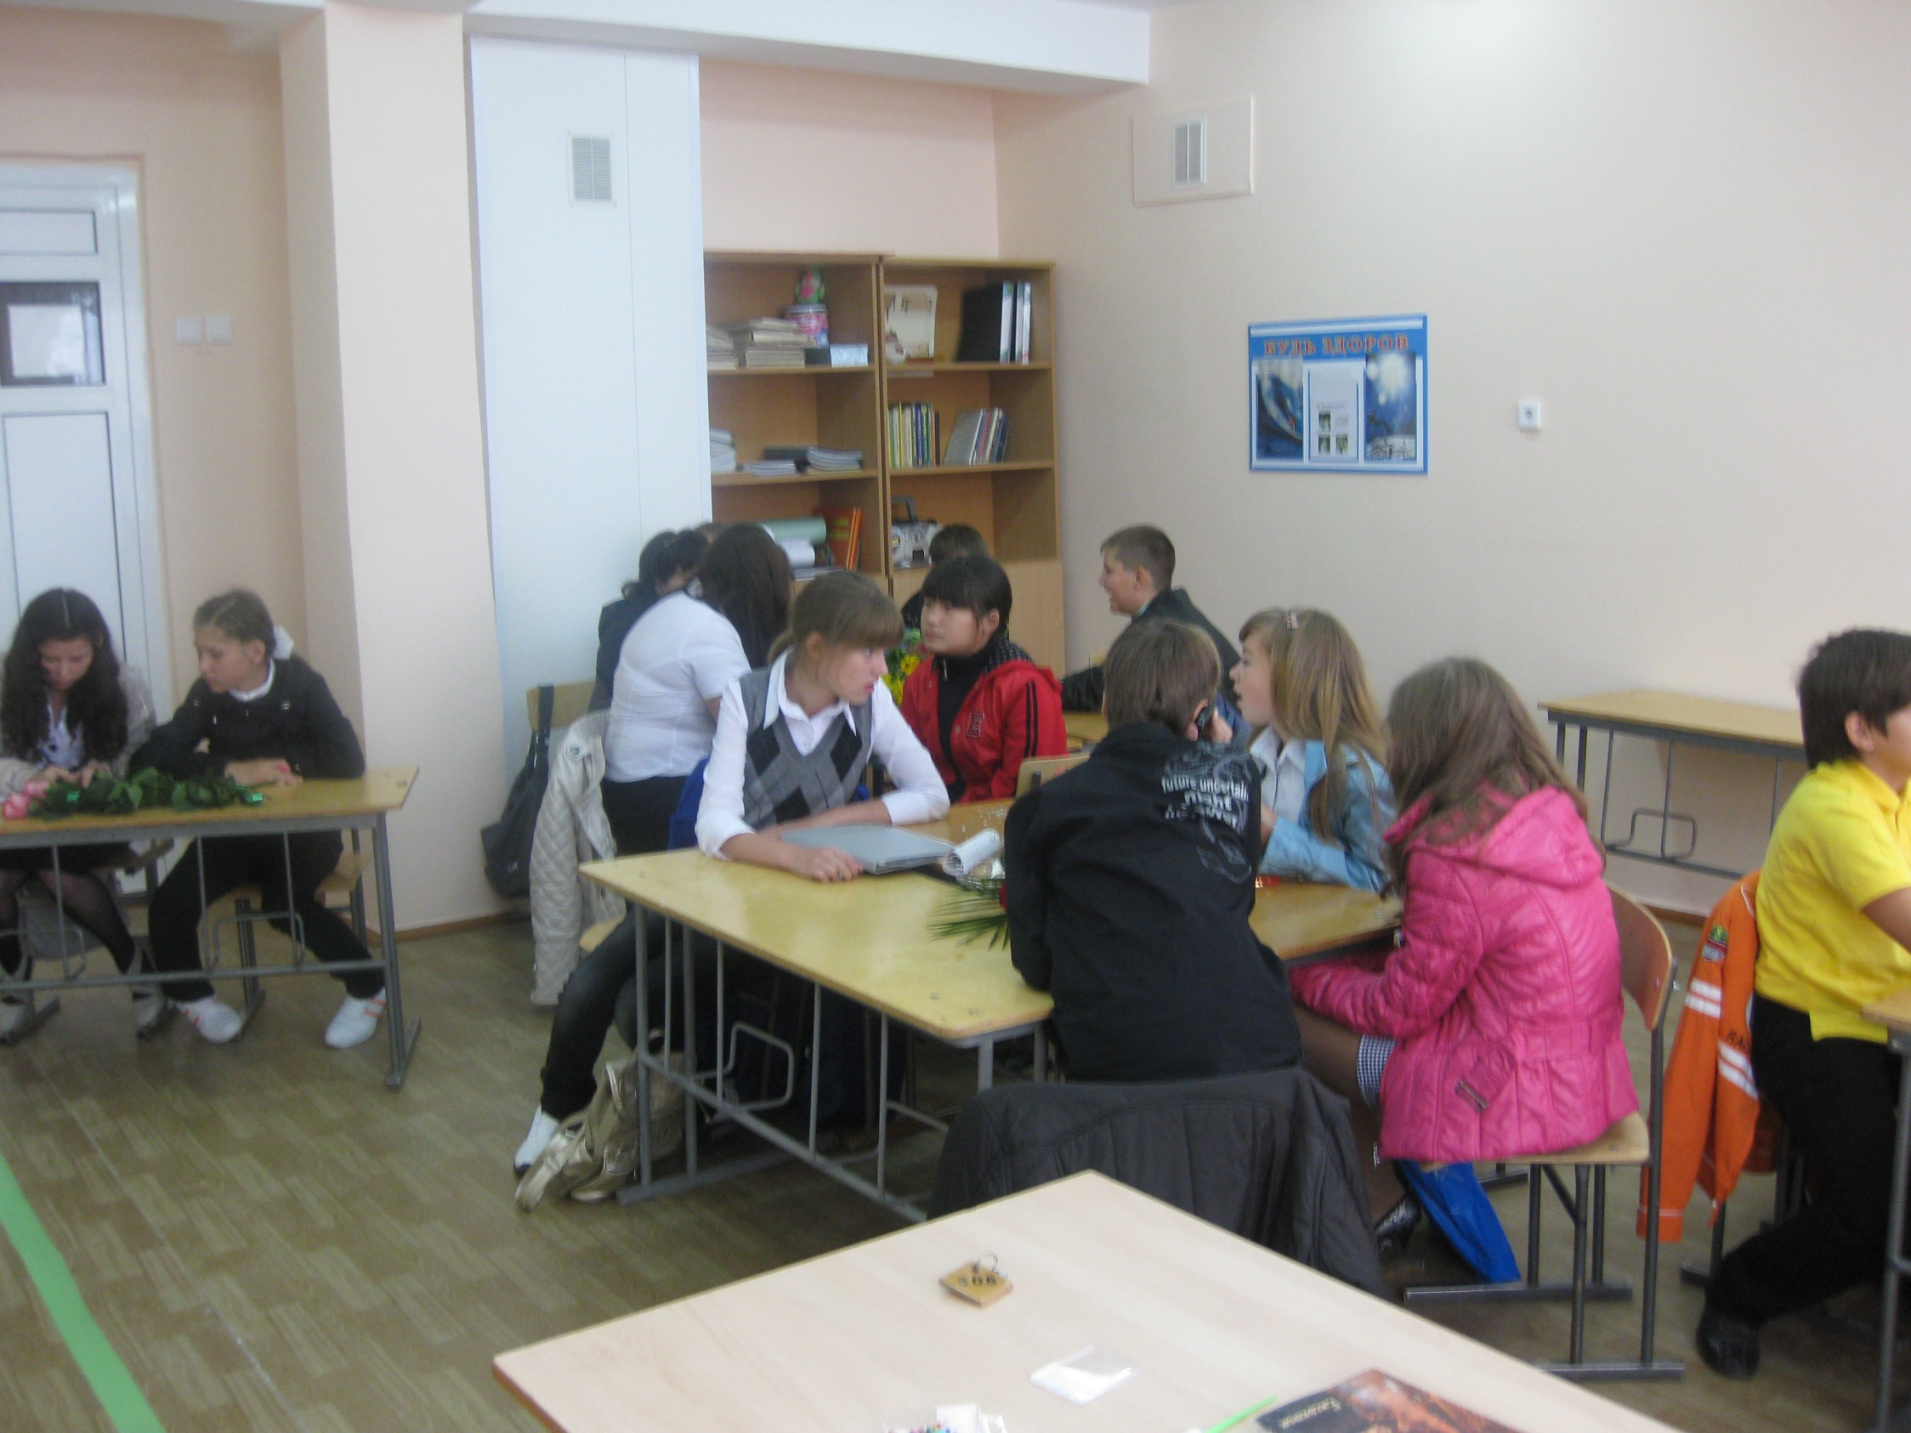

Slide 34
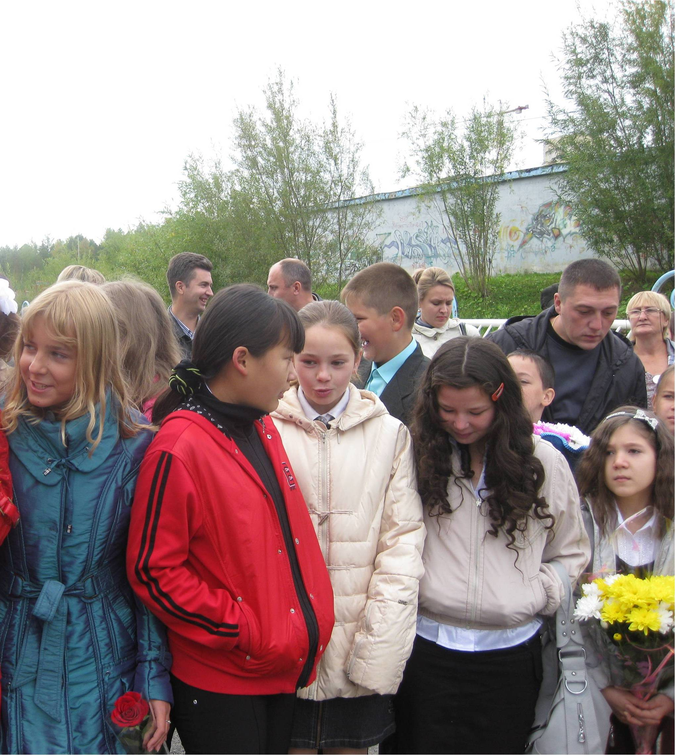

Slide 35
WE LOVE OUR TOWN!!!
The project was made by Bragina Natalya
Form 7 V
School №6
2010

