Slide 1
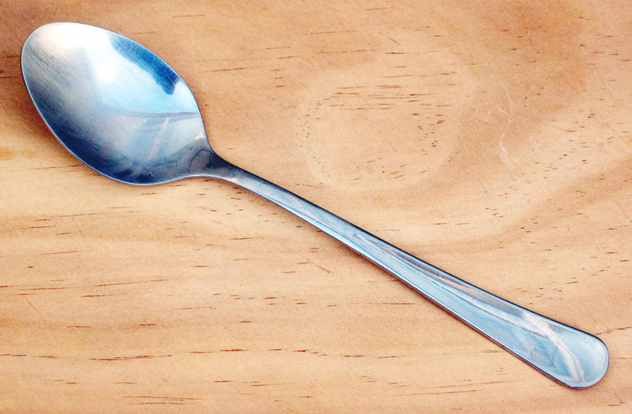
Spoon- a piece of cutlery with a shallow bowl-shaped container and a handle.Used to stir or to take up food.

Slide 2
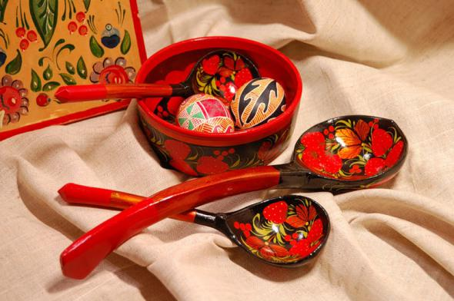
Russian Tradition and spoon

Slide 3
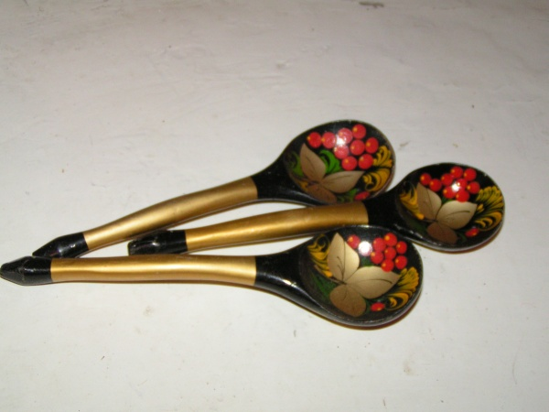
Wooden spoon
A wooden spoon is a spoon made from wood.

Slide 4
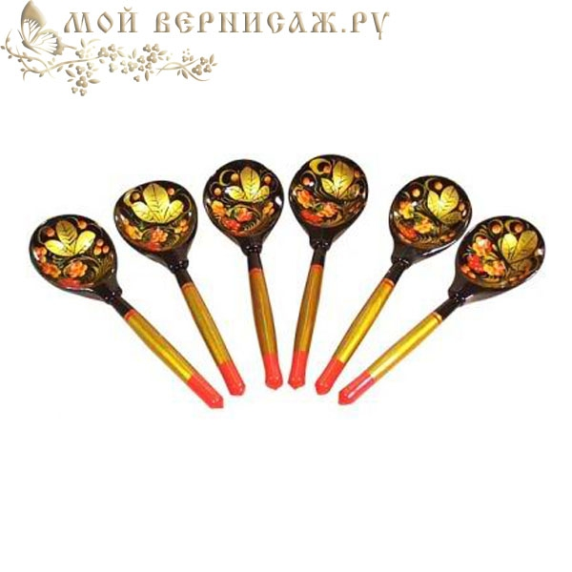
Wooden spoon
In Russia, wooden spoons were in every home.

Slide 5
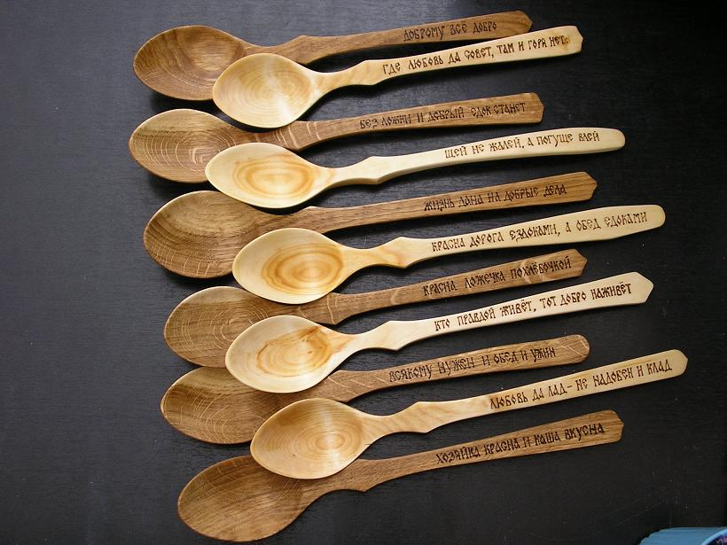
wooden spoon
More spoons
each painted differently.
But sometimes they are not painted

Slide 6
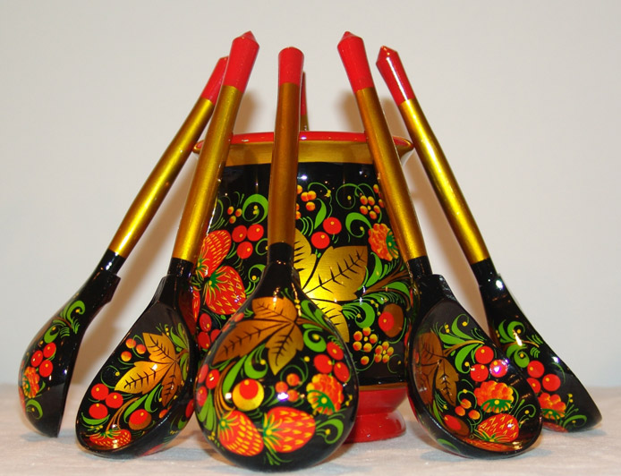
wooden spoon
But mostly used colors: red, black, gold

Slide 7
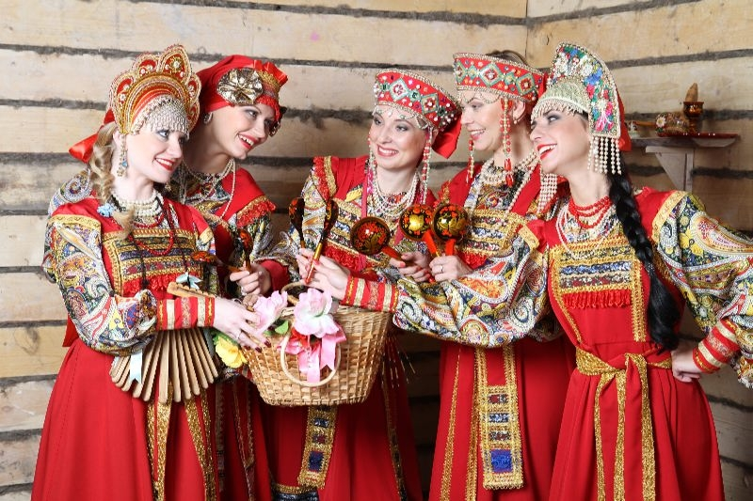
spoon as a musical instrument
in Russia, not only ate with spoons but also played on spoons

Slide 8
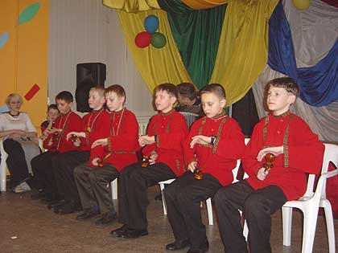
instruments spoons
In our time. People play on spoons as old times.

Slide 9
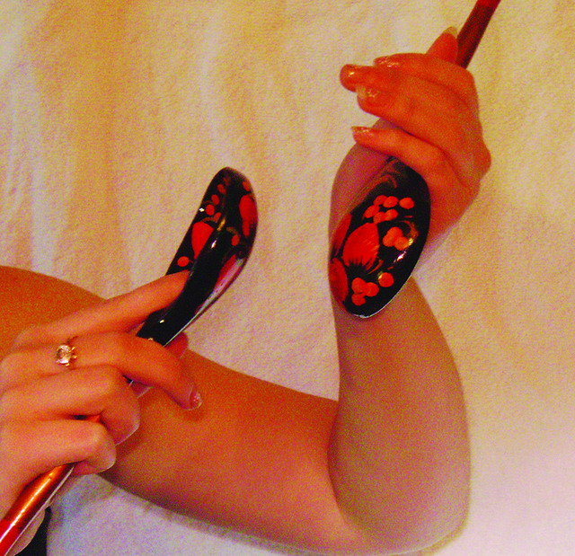
instruments spoons
The use of spoons for music dating at least from the 18th century . Typically, three or more wooden spoons are used to play

Slide 10
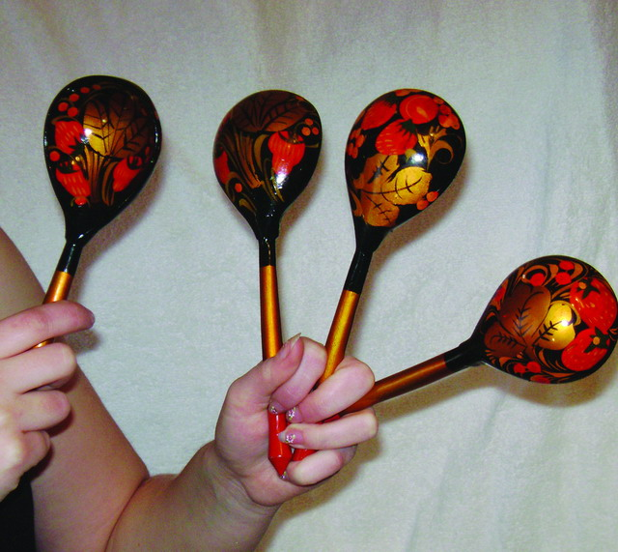
instruments spoons
For example, three spoons are held by their handles in the left hand, and the fourth, held in the right hand, is used to hit the tree spoons in the left hand.

Slide 11
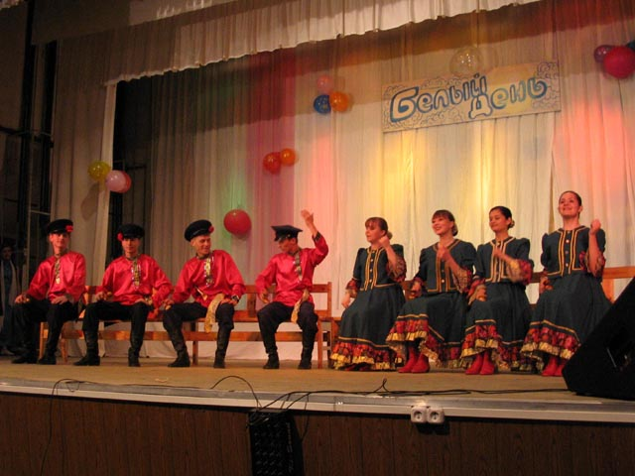
instruments spoons
These wooden spoons are commonly used in performances of Russian folk music and sometimes even in Russian orchestras.

Slide 12
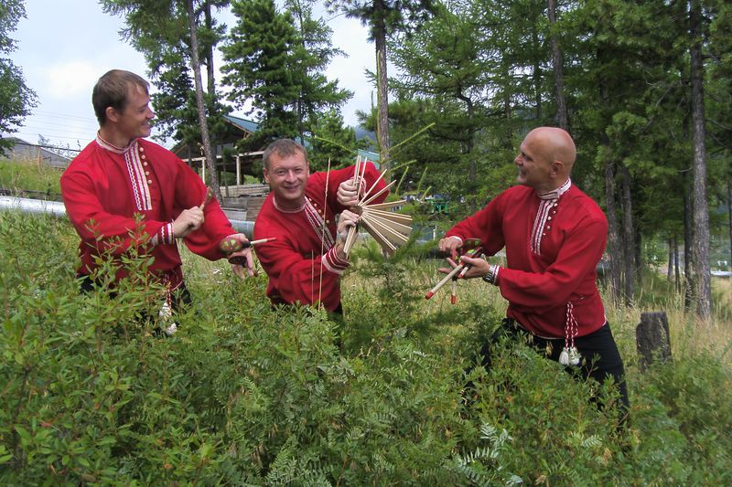
instruments spoons
As a result, wooden spoons, part of Russian culture

Slide 13
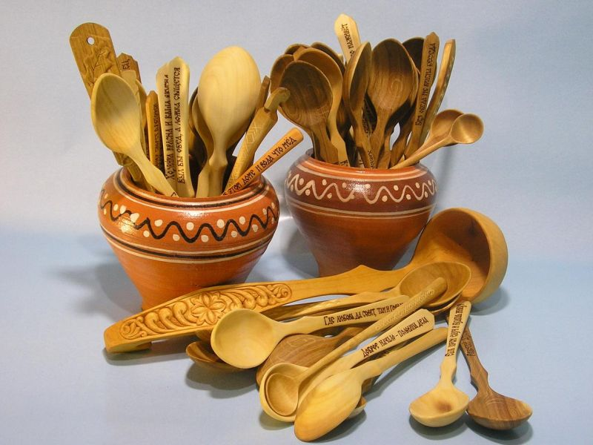
Where did the word "spoon"
The word "spoon" derives from an ancient word meaning a chip of wood or horn carved from a larger piece.

Slide 14
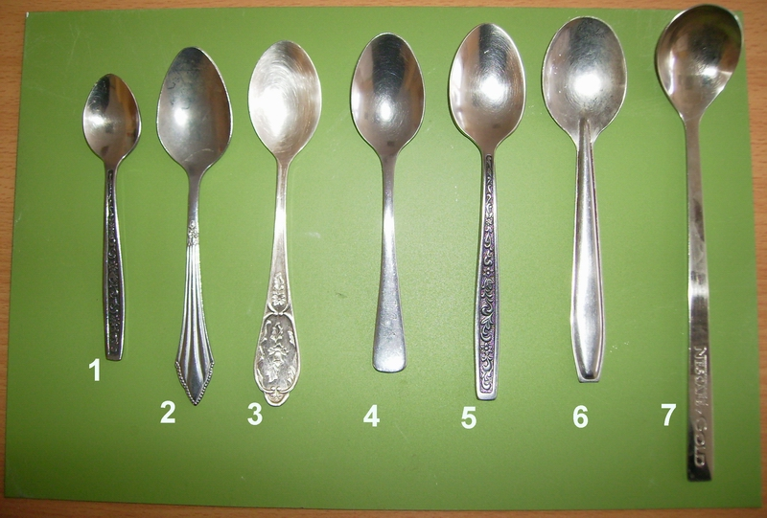
Spoons are different

Slide 15
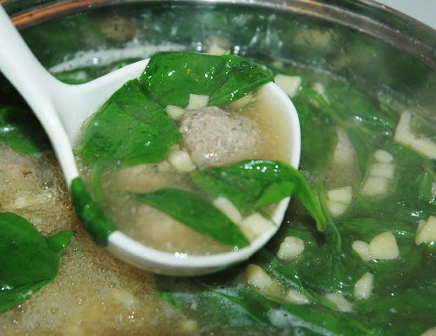
Ladle SPOON
Ladle spoon – a spoon with a long handle attached vertically for liquids.

Slide 16
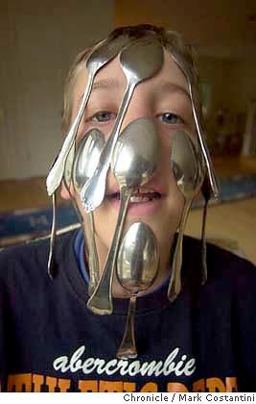
Tablespoon
Table spoon- a spoon larger than a dessert spoon.Used for serving.

Slide 17
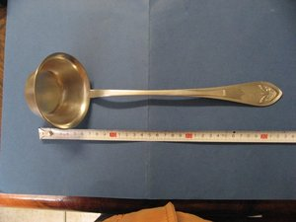
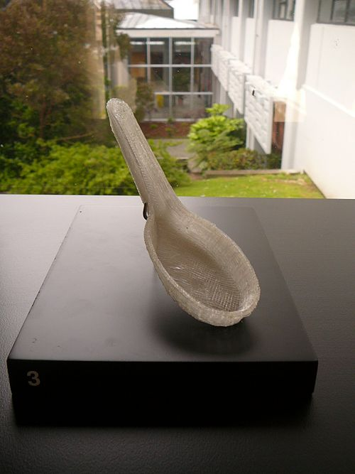
Soup spoon
Soup spoon- a spoon with a rounded bowl for eating soup - different types.
Metal soup spoon - similar in shape to a teaspoon.
Chinese soup spoon - usually ceramic and of a distinct Chinese soup spoon shape.

Slide 18
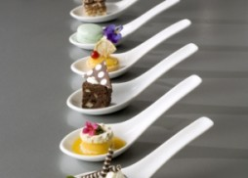
Dessert spoon
Dessert spoon- a spoon larger than a teaspoon and smaller than a tablespoon- between tablespoon and teaspoon in size.

Slide 19
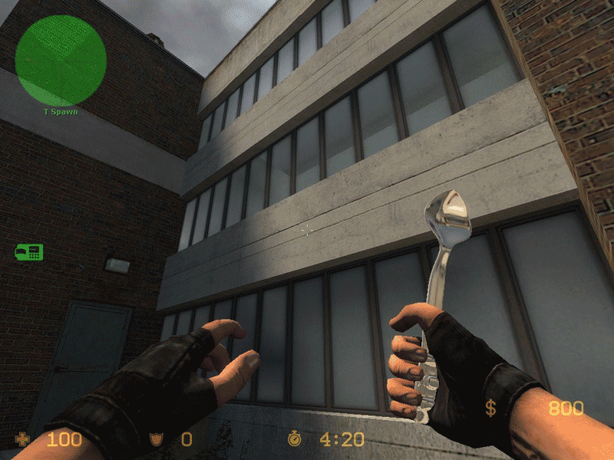
Teaspoon
Teaspoon - a small spoon used for stir-ring tea or coffee. Holds about one fluid dram.

Slide 20
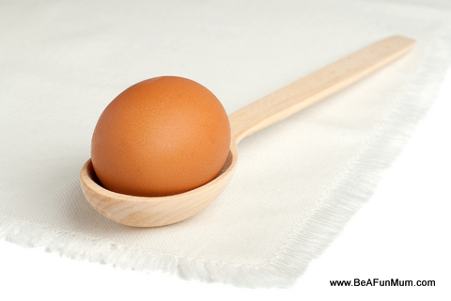
Egg spoon
Egg spoon - used for hens' eggs.Smaller than a teaspoon.

Slide 21
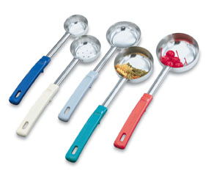
Spoodle
Spoodle - a cross between a spoon and a ladle,often used in europe in cooking particularly for soup and stew

Slide 22
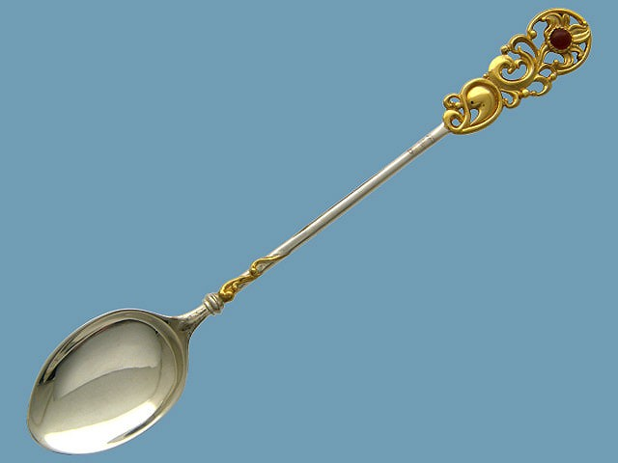
SiLver spoon
Silver spoon - a small spoon given to a newborn child to ensure good fortune.Used as a metaphor for someome born to riches.

Slide 23
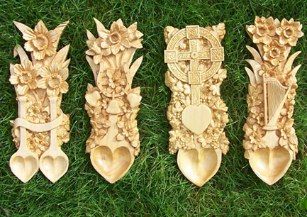
Love spoon
Love spoon - a carved wooden spoon given as a token of betrothal.

Slide 24
Municipal general establishment
«Secondary comprehensive school №6»
Authors:
Kiryanov Dima
Kisilev Bogdan
Aleksander Gelgorn
Form 9 B

