Slide 1
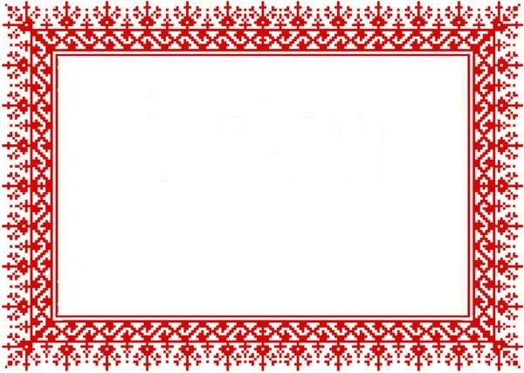
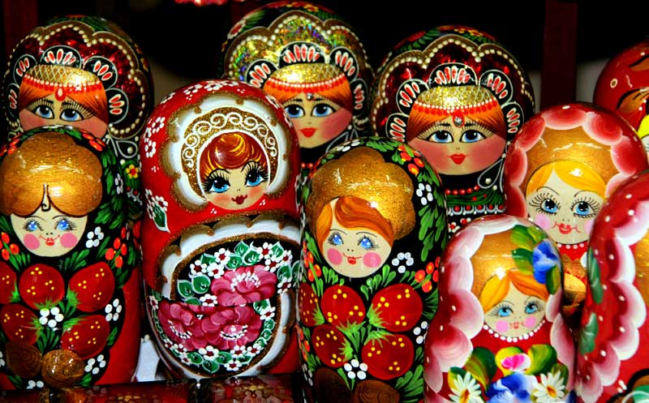
«Matryoshka» - symbol of Russia

Slide 2
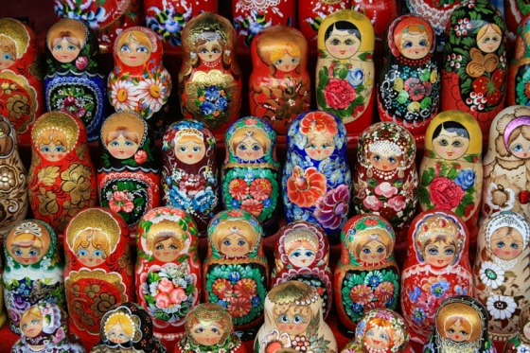
Russian stacking doll, or matryoshka, as it is called in Russian, is probably the most popular Russian national souvenir. It seems that the matryoshka has come to us from ancient times,from the world of legends and fairy tales. This wooden dolls is 100 years old.

Slide 3
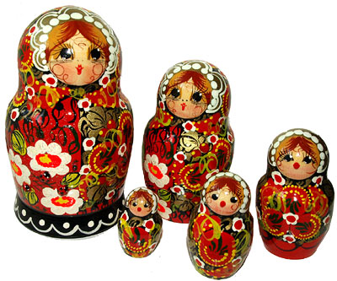
The matryoshka types were rather different:they portrayed both male and female characters. Gradually, the female character became the main type of matryoshka.

Slide 4
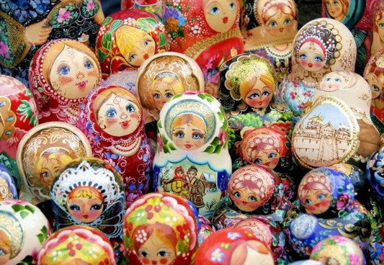
The Very Beginning of the Russian Matryoshka
The first Russian matryoshka was made in 1890 in the Children’s Educationwork-shop, situated inside the Abmramtsevo was Sava Mamontov, industrialist and parton of the arts.

Slide 5
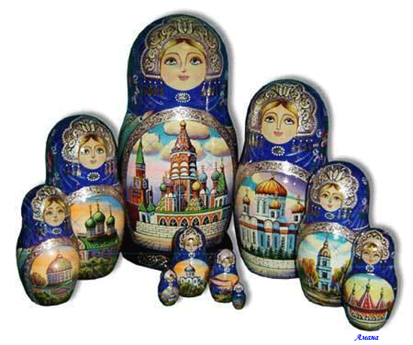
Why it is called «Matryoshka?»
Russian wooden dolls with smaller dolls inside are called matryoshkas. In old Russia? The name Matryona or Matriosha was a very popular female name. This name had means «Mother».

Slide 6
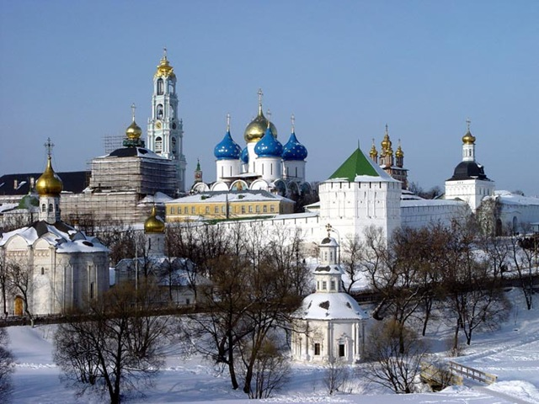
The Sergiev Posad style of Russian stacking dolls.
Sergiev Posad is the place where the first stacking dolls made by the artist Sergei Maliutin and the carver Vassiliy Zviozdochkin.
This old Russian town is located 73 km from Moscow.

Slide 7
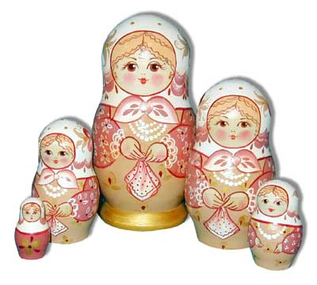
Arts and crafts flourished in the towns and villages surrounding the Sergius Monastery. Wooden toys, known as «Trinity». The first toy was made by the Abbot of the Monastery,Sergios Radonezhsky.

Slide 8
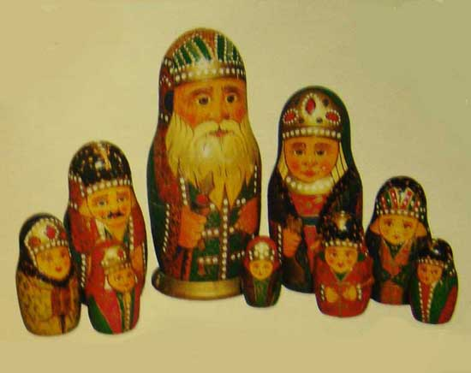
Sergiev Posad was a colorful,truly Russian town.
A professional artist made the first painted Sergiev Posad matryoshka just for fun.That is why these dolls are so expressive and have won the admiration of adults and children. In the initial period of matryoshka development,particular attention was paid to the faces of the matryoshka-clotes were not painted in detail.

Slide 9
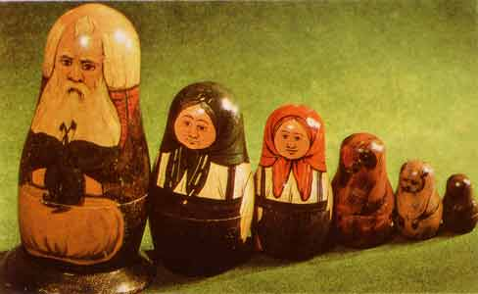
Sometimes, matryoshka portrayed whole families with numerous children and other members of the household
The Sergiev Posad matryoshka consisted of to pieces. In 1913,a 48-pieces matryoshka made by N.Bulichev was displayed at the Exbition of Toys in St.Peterburg.

Slide 10
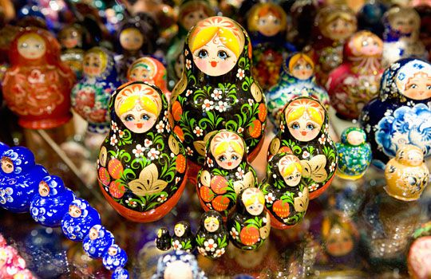
The folk art tradition was very important in the development of the present Sergiev Posad style.
In 1918,the unique Museum of Russian and Foreign Toys was opened in Sergiev Posad. The first Russian matryoshka by S.Maliutin is a part of its exbition. A 60-piece doll is considered the biggest Sergiev Posad matryoshka, made in 1967.

Slide 11
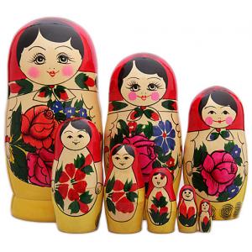
The Semionovo matryoshka
Semionovo is a large, old center of wooden handicrafts.Huge, thick forests and poor farming soil gave rise to the development of local folk crafts. Many changes occurred during the long history of crafts in Semionovo.

Slide 12
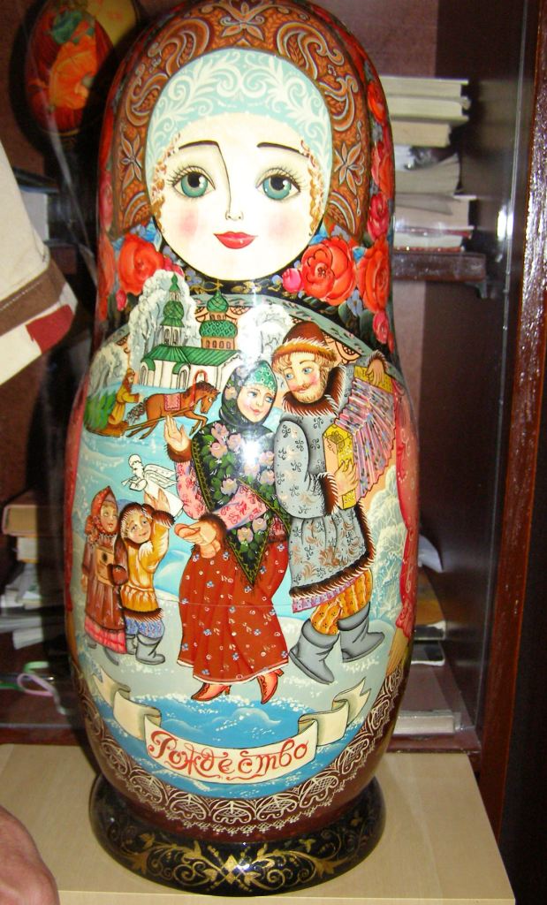
The Semionovo painters used aniline dyes and left quite a lot of unpainted space.
In the 80s, the Chief Artist Sorokin created a stacking doll couple, «Russian Lad» and «Russian Beauty». This couple was taken into space on June 29th
^{BY} Russian astronauts and was presented to the international crew

Slide 13
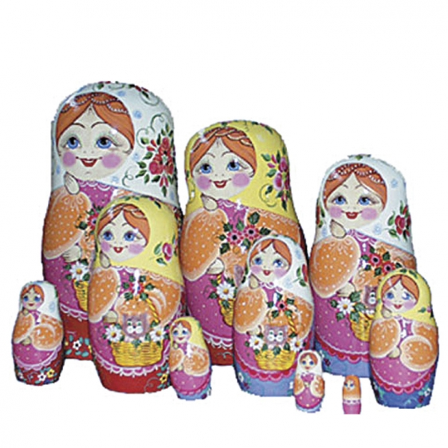
There is a legend that Semionovo was founded by the merchant Semion and a runaway monk from the Solovky monastery. Some crafts people made wooden toys for their children and just for fun, but in time, it became a profitable business.

Slide 14
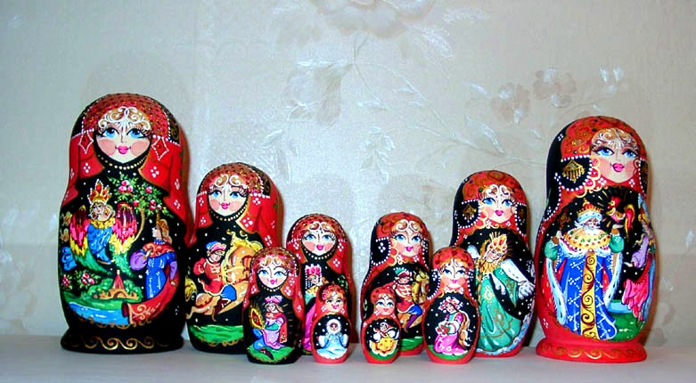
The first matryoshka in Semionovo was made by Arsenty Mayorov, well known for his wooden utensils, rattles, balls and apples. For almost years, the matryoshkas made by Mayorov were the best in Nizhny Novgorod area. In 1931, a studio making souvenirs, including matryoshkas, was established in Semionovo

Slide 15
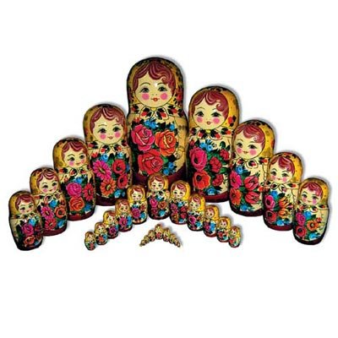
Thank you for your attention!

Slide 16
Municipal general establishment
«Secondary comprehensive school №6»
Authors:
Bragina Natalia
Mironova Alina
Tsvetkova Elizaveta
Form 9 V

